Slide 1

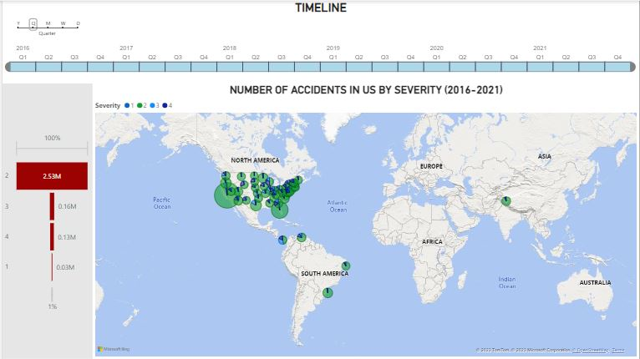
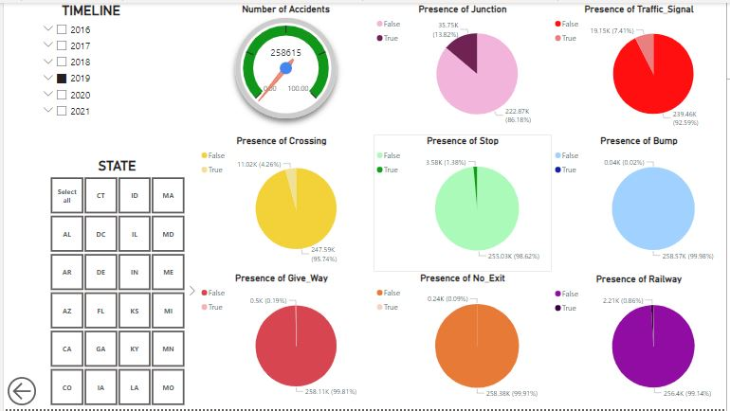
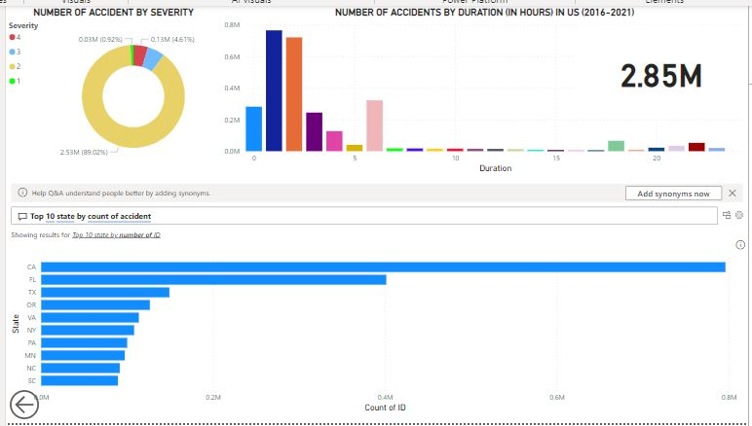
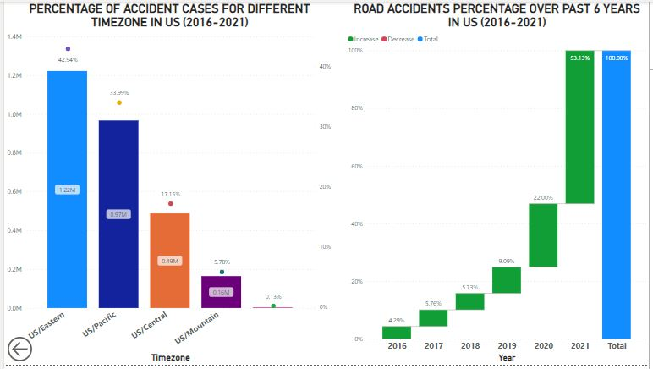
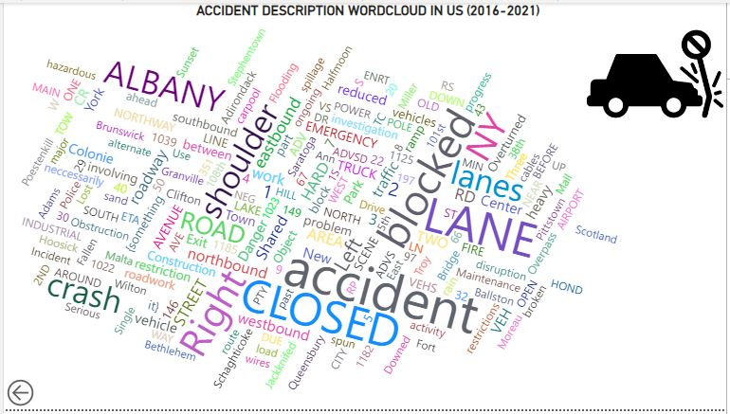
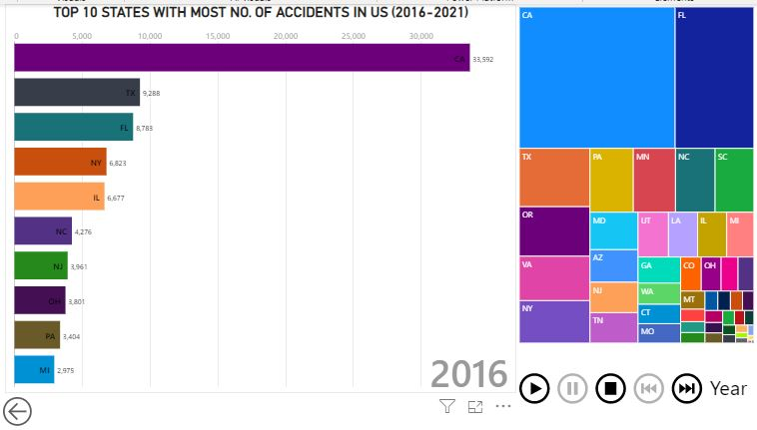
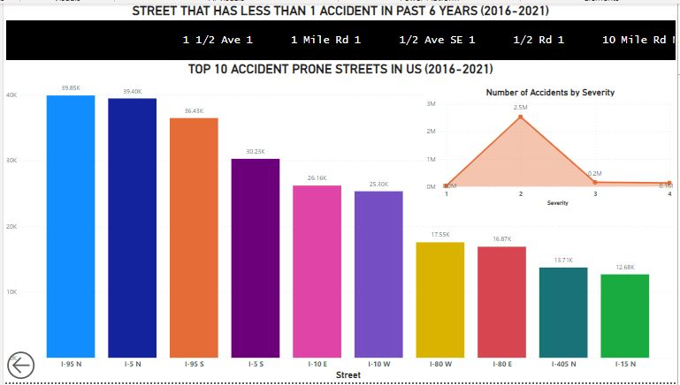
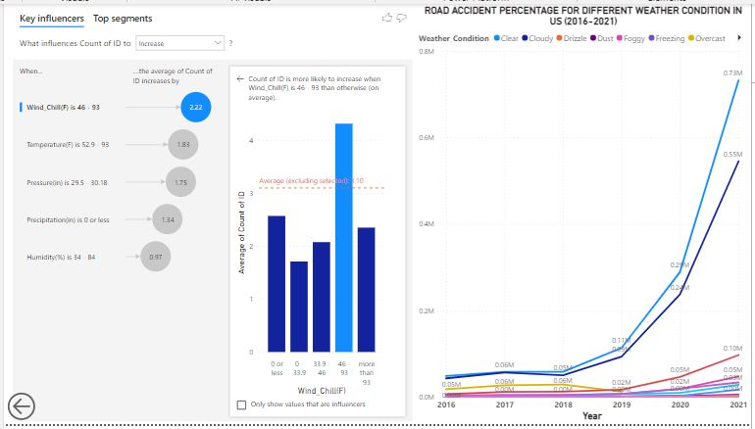
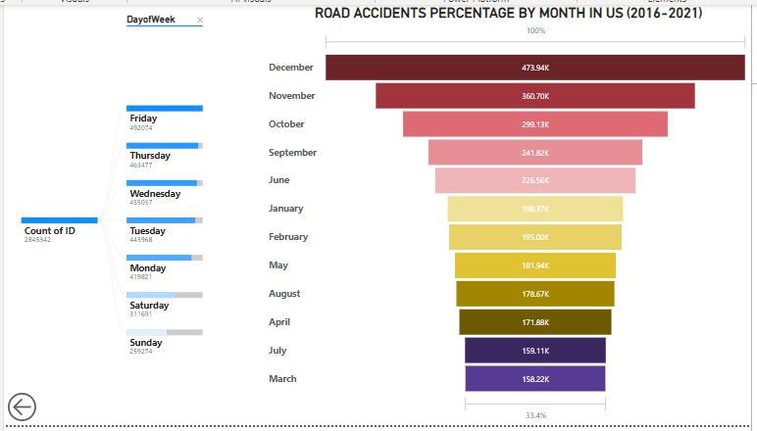
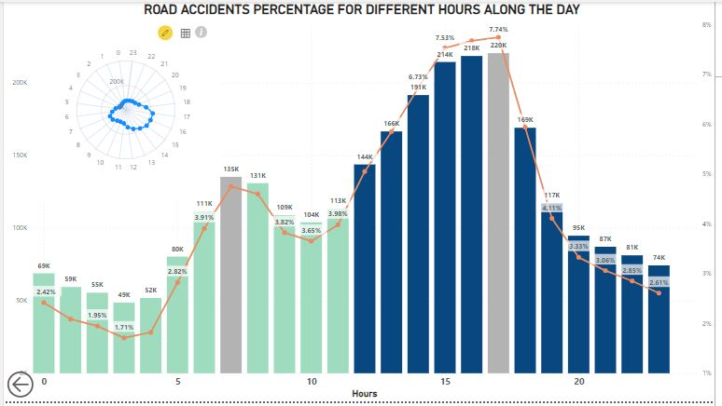
US ACCIDENTS (2016-2021)
Ngoc Oanh Nguyen
Link to the Power Bi’s Workspace https://app.powerbi.com/groups/me/reports/a332f4e7-857f-4731-862b-2cb49e78e76b/ReportSection?experience=power-bi
Business Reason
Car commuting – the most popular method of transportation in the world.
2021 – 282.4 million vehicles/ 228 million licensed drivers/ 3,140 billion miles driven annually.
Car accidents – a leading cause of death in the U.S.
2021 – A car accident occurs every 13 minutes
Vehicle death rate increased by 8.5%/ the mileage death rate increased by 2.7%/ the population death rate increased by 11%
Analysis of the trends that are emerging to improve the quality and safety of traveling on the road.
Real-time car accident prediction/ car accident hotspot locations/ casualty analysis/ cause and effect rules to predict car accidents/ the impact of precipitation/ environmental stimuli on accident occurrence.
Time analysis
The second degree of severity accounts for the greatest number of car accidents at about 90
The majority of them last from 1 to 2 hours
Q&A shows the corresponding graph according to the search keywords
Top 10 states that have the greatest number of car accidents by a bar chart, including California, Florida, Texas, etc
The Eastern time zone region of the US has the highest number of road accident cases (43%) - The Mountain time zone region of the US has the lowest (6%)
More than 75% of the total road accident records of this period happened only within the last 2 years (2020, 2021)
Number of accidents in the us by severity (2016-2021)
This is the map of accident severity by state.
The second degree of severity accounts for the largest number of car accidents
The pie chart in California state is the biggest one, possibly because it has the most population leading to a large equivalent number of accidents during the study period.
It is difficult to conclude that commuters encounter a larger possibility of having a car accident when living in here than other states.
Other degrees of severity have remained at a low level over the years.
Road Condition Analysis
99.98% of cases – the bumper was absent in the accident spot
4.26% of cases – road accidents happened near the crossing
98.62% of cases – no stop near the accident area
13.82% of road accident cases were recorded near the junctions.
92.59% of road accident cases were recorded far from the traffic signal
→ Increase the presence of bumper, traffic signals, or stop signs on the street to control the traffic flow
CHART HERE
DATASET
Available on Kaggle
49 states – February 2016 to March 2023 – multiple APIs
7.7 million accident records
Use the updated dataset until December 2021 with more than 2.5 million records
Insurance agents and adjusters/ vehicle owners and operators/ state, regional, and local government agencies/ emergency response agencies/ auto bodies/ mechanic shops/ towing companies
Cost of insurance, accident likelihood, and safety features
Promulgate a law to make traffic flows and their streets safer
Accurately redetermine pricing for market coverages
Prevent more future research and practice in this field.
Top 10 sates with the greatest number of accidents in the US (2016-2021)
Top 10 accident prone streets in the US (2016-2021)
Compare Tableau vs Power BI
Similar to a certain extent
Produce a variety of different visualizations
Connect to numerous data sources
Code-free and user-friendly
Support interactive interfaces
I like the design language of Tableau and the transforming data power of Power BI
→ Each of them is superior in their own field
3W lessons
What Went Well
The data preparation did not take so much time
Rich in features and visualizations & quite similar to Tableau
Detailed tutorials & available documents/information on the forum
What Did NOT Go Well
Finding a dataset with all the required attributes is extremely time-consuming
Huge amount of data – slow & take a lot of time
Not have many numeric attributes – repeatedly use the same one
Create some new measures – DayofWeek/Month/Hour/Duration
Limited data – visualizations are not beautiful and consistent – quite forced
What Would I Do Differently Next Time
Spend more time finding the data & understanding each attribute more comprehensively
Explore the rich set of available features of Power BI & Parameter feature
Try a different larger dataset with different visualization tools (Metabase/Zoho)
Time Analysis
In the evening, around 27% of road accidents occurred between 2:00 PM to 6:00 PM
The most-deadliest accident hour is 5:00 PM implies the evening office-returning hour
Around 18% of road accidents occurred between 6:00 AM to 9:00 AM
The second deadliest accident hour is 7:00 AM implying the morning office-going hour
The radar chart also gives the overall picture of the distribution of the number of accidents during the day
Road accidents percentage by Day of Week & Month
(2016-2021)
Weather Analysis
In most road accident cases, the weather was clear and cloudy
“Key Influencers” shows that when the wind chill is from 46 to 93 Fahrenheit degrees, it tends to be the key influence in increasing the number of accidents by 2.2 compared to other factors, including temperature, pressure, precipitation, and humidity.

